Slide 1
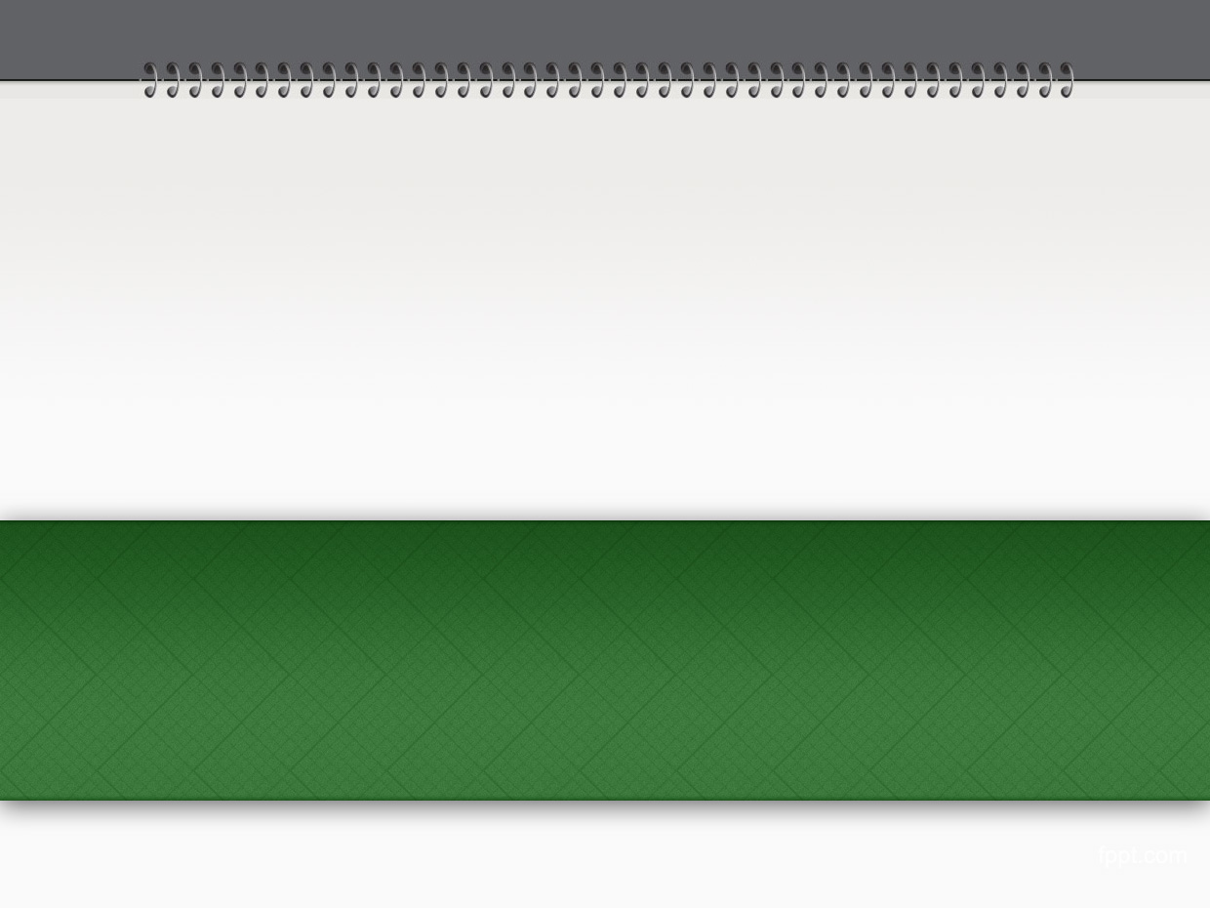
Chapter 9: Work with email
Summary from book “Beginning Rails 3 - Cloves Carneiro Jr_”

Slide 2
Sample code
Repo: git@github.com:pingovn/pingo-rails-basic.git
Branch: chapter 9

Slide 3
Target
At end of this chapter, you could
  Config email working environment
  Implement sending email with Mailer
  Use templates for different categories

Slide 4
Overview
Most of applications need email features. It is not only used by users but also admin.
  Ex: you want to send an email to all users to notify that there is a change of term & service’s policies.
Action mailer support SEND & RECEIVE emails. We will investigate “send” feature in this chapter.
Sometimes, we bring up more than 1 mail server for different environment (ex: development, production,..)

Slide 5
Setup Action Mailer
Mail server: Rails does not have built-in mail server so that we need to indicate where Rails could find mail server out, and how to communicate with it.
Popular mail server:
  Sendmail (Linux, OS X, UNIX based OS)
    Change config/environments/*.rb to include ActionMailer::Base.delivery_method = :sendmail;
  Simple Mail Transfer Protocol (SMTP)
    We will focus to this system

Slide 6
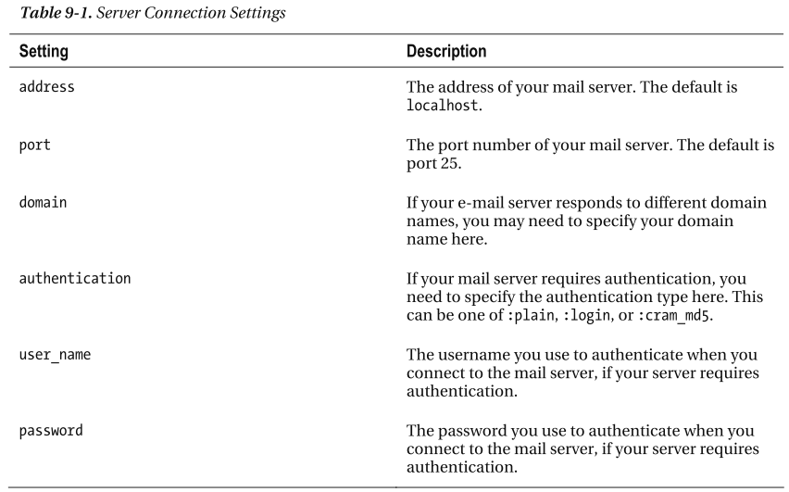
SMSP

Slide 7
SMTP
config/environments/development.rb
  # Email configuration
  config.action_mailer.raise_delivery_errors = true
  # Gmail SMTP server setup
  ActionMailer::Base.smtp_settings = {
  :address => "smtp.gmail.com",
  :enable_starttls_auto => true,
  :port => 587,
  :authentication => :plain,
  :user_name => “your-email@gmail.com",
  :password => ‘your-password'
  }
Please restart rails server after you change any config.

Slide 8
Tip
As you see, the password is put inside config file. For security purpose, we SHOULD NOT put the password in code or any files included in repository.
Rails has gem that supports this purpose such as “foreman”.

Slide 9
Sending email feature
Target:
  We will add a link to article page.
  When a user finds the article interest, he could send it to his friend by
    Click to email link
    Input his friend’s email address
    Submit the request to controller
    Controller calls Action Mailer

Slide 10
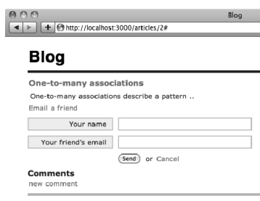
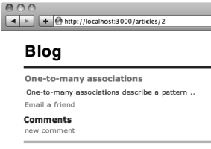
Sending email feature

Slide 11
Generate mailer
$ rails generate mailer Notifier email_friend
app/mailers/notifier.rb
  class Notifier < ActionMailer::Base
  default :from => “your-default-mail-address"
  def email_friend
  @greeting = "Hi"
  mail :to => “to-email-address"
  end
  end

Slide 12
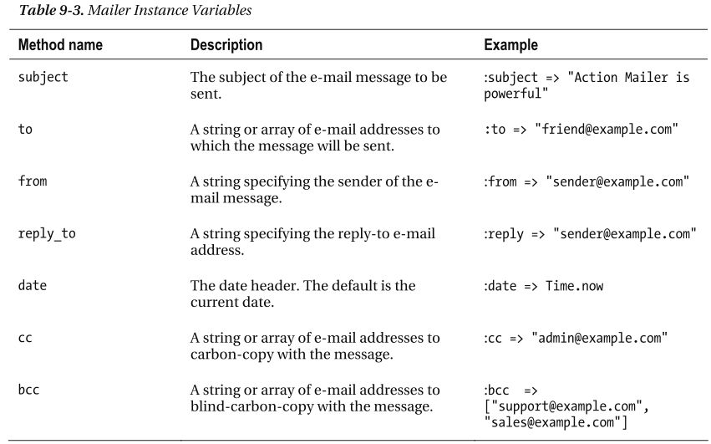
Options of “mail” method

Slide 13
Add email link to view
app/views/articles/_notify_friend.html.erb
<%= form_tag(notify_friend_article_path(@article), :id => 'notify_friend_form',
:style => 'display:none') do %>
<div class="field">
<%= label_tag :name, 'Your name' %><br />
<%= text_field_tag :name %>
</div>
<div class="field">
<%= label_tag :email, "Your friend's email" %><br />
<%= text_field_tag :email %>
</div>
<div class="actions">
<%= submit_tag 'Send' %> or
<%= link_to 'Cancel', '#', :onclick => "$('#notify_friend_form').slideUp()" %>
</div>
<% end %>
app/views/articles/show.html.erb
<%= link_to 'Email a friend', '#',
:onclick => "$('#notify_friend_form').slideDown()" %>
<%= render 'notify_friend' %>

Slide 14
Add email method to controller
app/controllers/articles_controller.rb
  class ArticlesController < ApplicationController
  before_filter :authenticate, :except => [:index, :show, :notify_friend]
  def notify_friend
  @article = Article.find(params[:id])
  Notifier.email_friend(@article, params[:name], params[:email]).deliver
  redirect_to @article, :notice => "Successfully sent a message to your friend"
  end
  “Notifier” is the mailer that we generated in previous step.

Slide 15
LAB
Please execute above steps & confirm if email could be sent
Please:
  Change email subject to “Interesting Article”

Slide 16
Email template (TEXT)
app/views/notifier/email_friend.text.erb
  Your friend <%= @sender_name %> thinks you may like the following article:
  <%= @article.title %>: <%= article_url(@article, :host => "localhost:3000") %>

Slide 17
Email template (HTML)
app/views/notifier/email_friend.html.erb
  <html>
    <body>
      <p>
      One of your friends, <%= @sender_name %>,
      thinks you like an article we have written.
      </p>
      <p>
      Come check all the information about <strong><%= @article.title %></strong> at
      <%= article_url @article, :host => 'localhost:3000' %>
      </p>
    </body>
  </html>

Slide 18
Attachment
  class Notifier < ActionMailer::Base
  default :from => "from@example.com"
  def email_friend(article, sender_name, receiver_email)
  @article = article
  @sender_name = sender_name
  attachments["rails.png"] = File.read(Rails.root.join("public/images/rails.png"))
  mail :to => receiver_email, :subject => "Interesting Article"
  end
  end
  Receiver will get an attachment with name “rails.png”

Slide 19
LAB
Target: we want to implement notification feature. Article author will get notification email whenever someone else add a comment to his post
Tip:
  Author email is available in “users” table
  We put email title as article’s title
  Use callback to send email “after_create” an comment (add it to model as a callback or in observer)

Slide 20
Summary
You learned
  The way to setup mail server using SMTP
  Create a mailer
  Change views (add email link), controllers (to execute notifier)
  Know how to add an attachment

Slide 21
Advance tips
SMTP is good for most of usage. However, if we need to send a lot of email at once, we should use a third party service such as sendgrid (http://sendgrid.com/). It supports to manage deliver status, chart diagrams, mass email sending (a lot of emails),…
Use should have setting to enable/disable notification email. This is done via “unsubscribe” link at footer of each email.
For notification purpose, you could create a “notification model” to keep messages. Each message should be read/unread state.

